Slide 1
Link-State Routing Protocols

Slide 2
Objectives
Describe the basic features & concepts of link-state routing protocols.
List the benefits and requirements of link-state routing protocols.

Slide 3
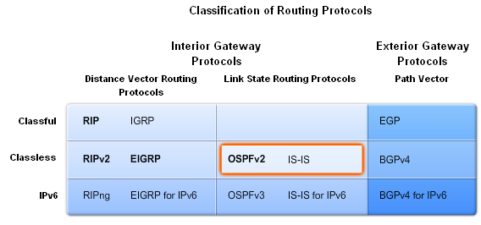
Link-State Routing
Link state routing protocols
  -Also known as shortest path first algorithms
-These protocols built around Dijkstra’s SPF

Slide 4
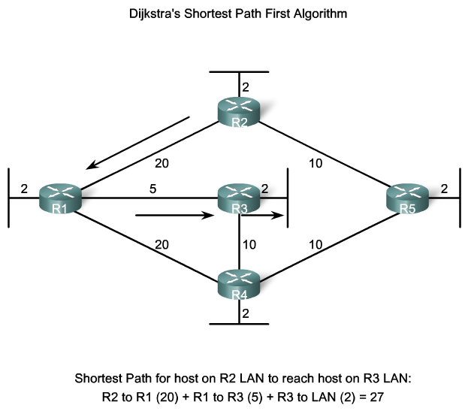
Link-State Routing
Dikjstra’s algorithm also known as the shortest path first (SPF) algorithm

Slide 5
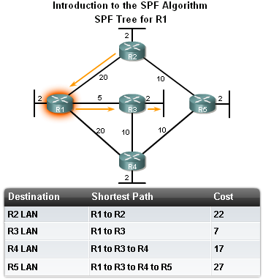
Link-State Routing
The shortest path to a destination is not necessarily the path with the least number of hops

Slide 6
Link-State Routing
Link-State Routing Process
How routers using Link State Routing Protocols reach convergence
    -Each routers learns about its own directly connected networks
    -Link state routers exchange hello packet to “meet” other directly connected link state routers.
    -Each router builds its own Link State Packet (LSP) which includes information about neighbors such as neighbor ID, link type, & bandwidth.
    -After the LSP is created the router floods it to all neighbors who then store the information and then forward it until all routers have the same information.
    -Once all the routers have received all the LSPs, the routers then construct a topological map of the network which is used to determine the best routes to a destination

Slide 7
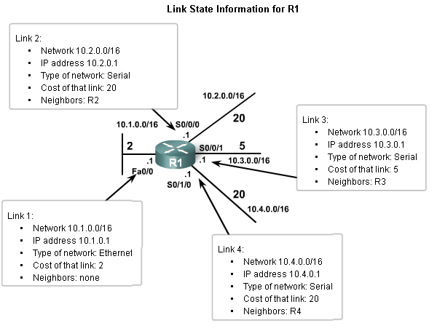
Link-State Routing
Directly Connected Networks
Link
  This is an interface on a router
Link state
  This is the information about the state of the links

Slide 8
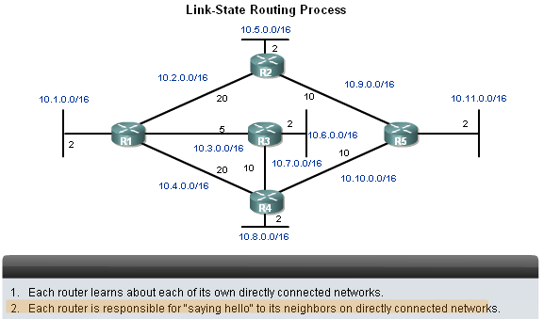
Link-State Routing
Sending Hello Packets to Neighbors
Link state routing protocols use a hello protocol
Purpose of a hello protocol:
-To discover neighbors (that use the same link state routing protocol) on its link

Slide 9
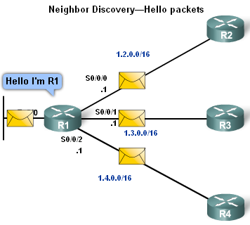
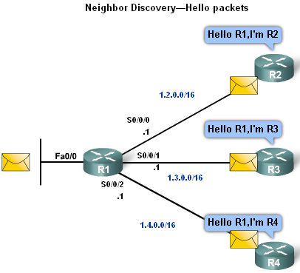
Link-State Routing
Sending Hello Packets to Neighbors
Connected interfaces that are using the same link state routing protocols will exchange hello packets.
Once routers learn it has neighbors they form an adjacency
-2 adjacent neighbors will exchange hello packets
-These packets will serve as a keep alive function

Slide 10

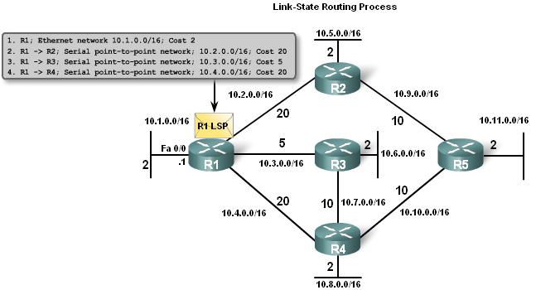
Link-State Routing
Building the Link State Packet
Each router builds its own Link State Packet (LSP)
Contents of LSP:
-State of each directly connected link
-Includes information about neighbors such as neighbor ID, link type, & bandwidth.

Slide 11
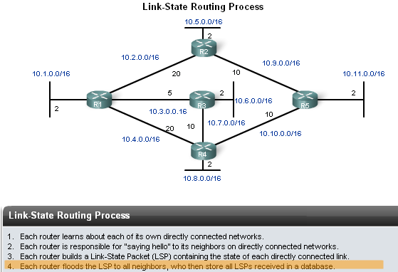
Link-State Routing
Flooding LSPs to Neighbors
Once LSP are created they are forwarded out to neighbors.
  -After receiving the LSP the neighbor continues to forward it throughout routing area.

Slide 12
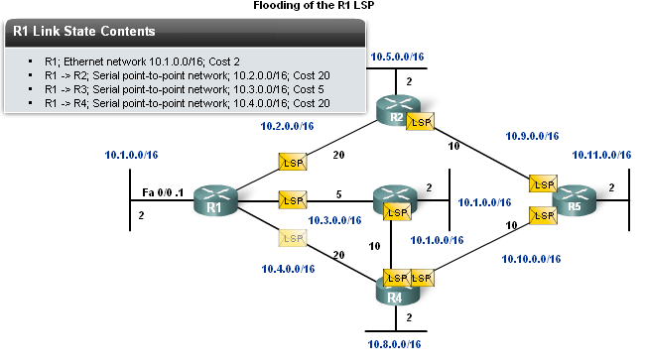
Link-State Routing
LSPs are sent out under the following conditions
-Initial router start up or routing process
-When there is a change in topology

Slide 13
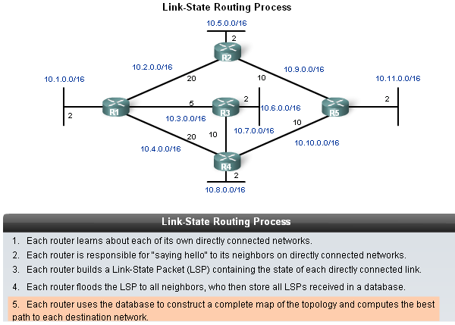
Link-State Routing
Constructing a link state data base
Routers use a database to construct a topology map of the network

Slide 14
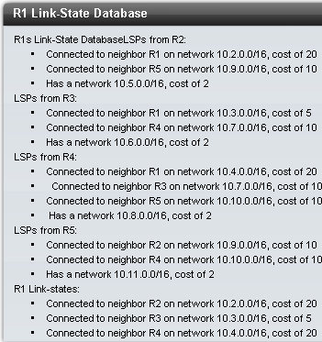
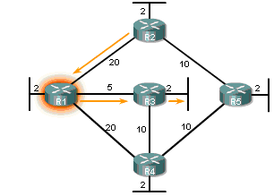
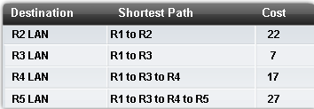
Link-State Routing

Slide 15
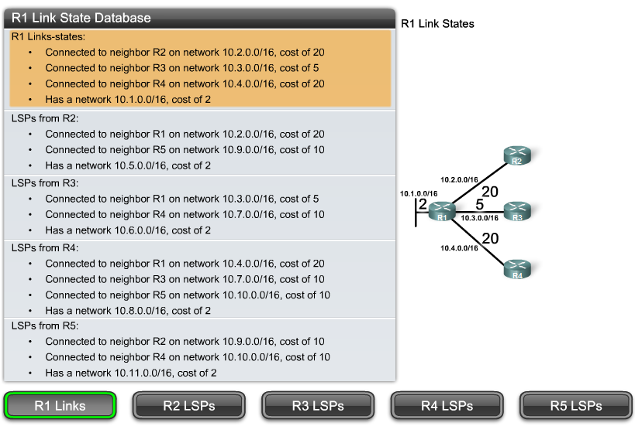
Creating SPF Tree

Slide 16
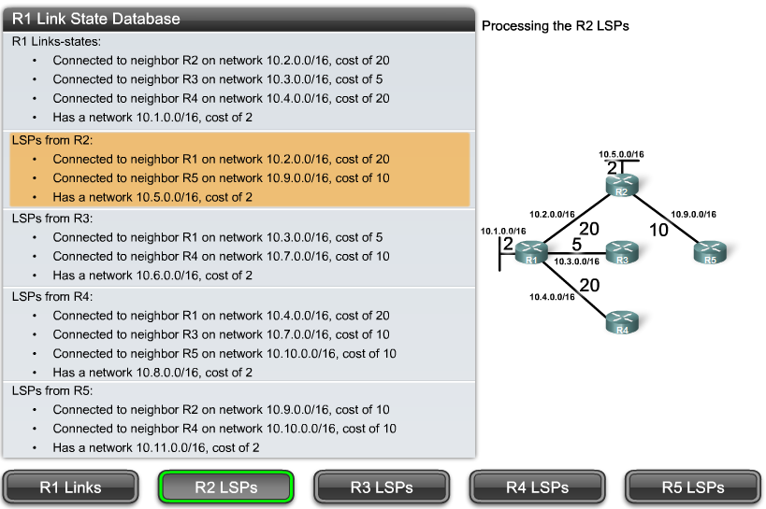
Creating SPF Tree

Slide 17
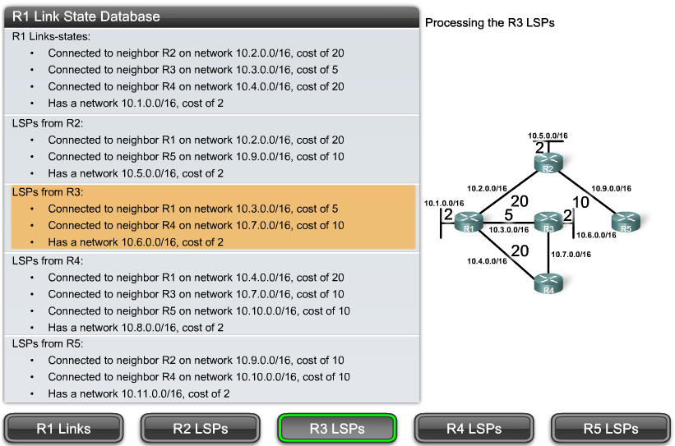
Creating SPF Tree

Slide 18
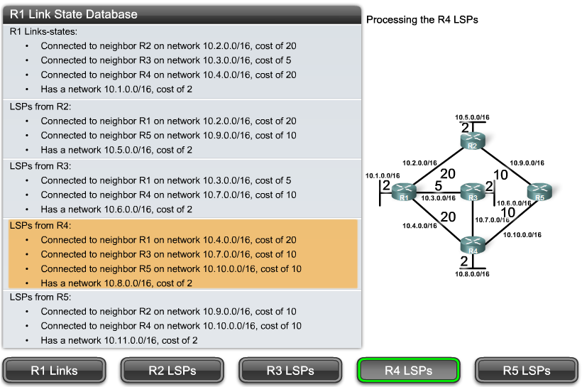
Creating SPF Tree

Slide 19
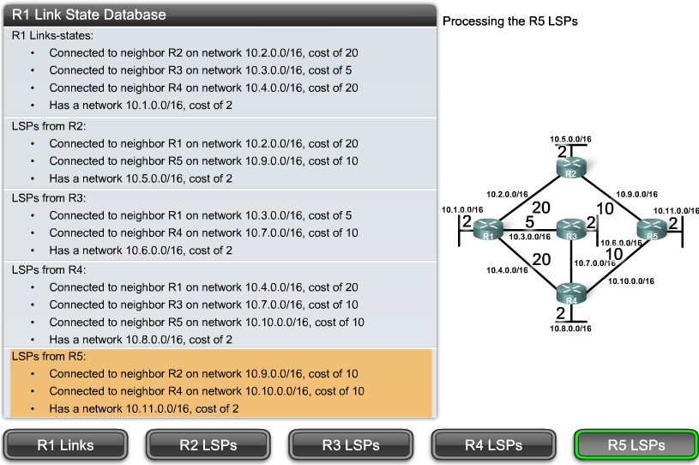
Creating SPF Tree

Slide 20
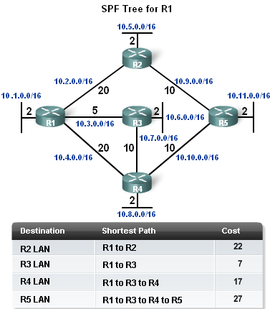
Link-State Routing
Determining the shortest path
  The shortest path to a destination determined by adding the costs & finding the lowest cost

Slide 21
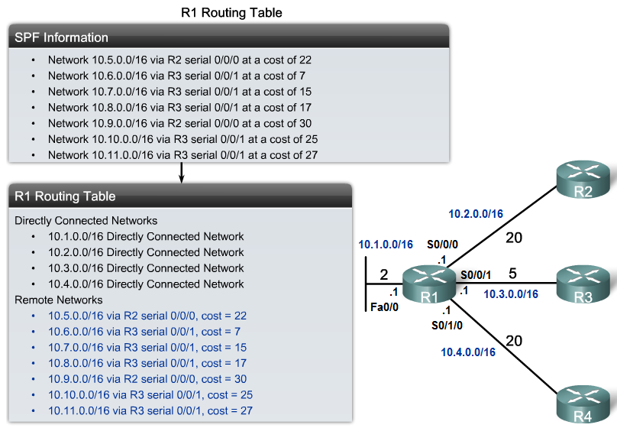
Link-State Routing
Once the SPF algorithm has determined the shortest path routes, these routes are placed in the routing table.

Slide 22
Link-State Routing Protocols
Advantages of a Link-State Routing Protocol
Routing protocol | Builds Topological map | Router can independently determine the shortest path to every network. | Convergence | A periodic/ event driven routing updates | Use of LSP
Distance vector | No | No | Slow | Generally No | No
Link State | Yes | Yes | Fast | Generally Yes | Yes

Slide 23
Link-State Routing Protocols
Requirements for using a link state routing protocol
Memory requirements:
Typically link state routing protocols use more memory.
Processing Requirements:
More CPU processing is required of link state routing protocols.
Bandwidth Requirements:
Initial startup of link state routing protocols can consume lots of bandwidth.

Slide 24
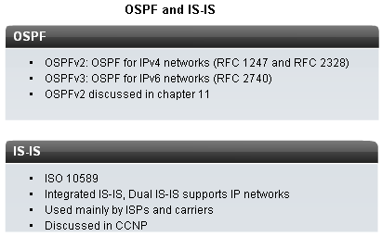
Link-State Routing Protocols
2 link state routing protocols used for routing IP
-Open Shortest Path First (OSPF)
-Intermediate System-Intermediate System (IS-IS)

